Slide 1

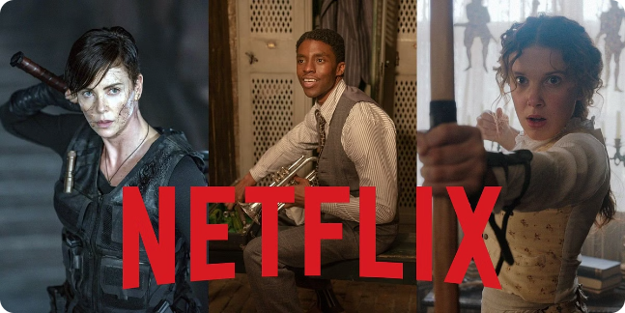
By JAYJEET TUDU

Slide 2

Project Title
Netflix Movies and TV Shows

Slide 3
Agenda
Introduction: Welcoming remarks and a brief overview of the presentation.
Popular Movies: A look at the trending movies currently on Netflix.
Popular TV Shows: Exploring the most-watched TV shows available on Netflix.
Genres: An overview of the diverse genres of content accessible on Netflix.
Search and Recommendations: Understanding the algorithms behind Netflix's personalized content suggestion system.
User Interface: Analysing the design and user experience of the Netflix platform.
Conclusion: Summarizing key takeaways and closing remarks.

Slide 4
Problem Statement
The challenge is to create a user-friendly platform that allows Netflix subscribers to easily discover and access a diverse range of high-quality movies and TV shows. The platform needs to effectively utilize search and recommendation algorithms to enhance the user experience and engage viewers.

Slide 5


Popular Movies on Netflix
Netflix offers a diverse range of popular movies, from thrilling action blockbusters to heartwarming dramas.
Explore a wide selection of critically acclaimed films, spanning various genres and captivating storytelling.
With Netflix's vast movie collection, there's always something for everyone to enjoy.

Slide 6
Popular TV Shows on Netflix
Netflix offers a diverse range of popular TV shows, including thrilling dramas, captivating comedies, and compelling documentaries.
From binge-worthy series to thought-provoking documentaries, Netflix's collection of TV shows caters to a wide variety of tastes and preferences.
Explore the platform to discover acclaimed and entertaining TV shows that keep viewers hooked season after season.

Slide 7




Genres available on Netflix
Action
Comedy
Documentary
Drama
Exciting, high-energy films and TV shows with thrilling plots and intense scenes.
Lighthearted and humorous content aimed at entertaining and eliciting laughter.
Captivating, real-life storytelling and compelling non-fiction narratives.
Emotionally engaging, character-driven content and impactful storytelling.

Slide 8
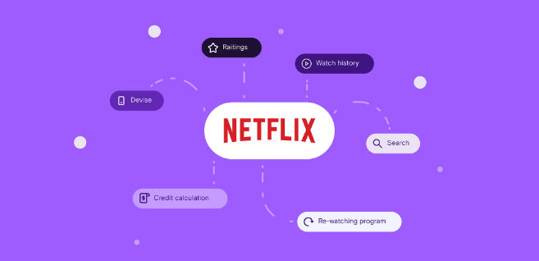
Search and recommendation algorithms
Netflix employs sophisticated algorithms that analyze user behavior, preferences, and viewing history to recommend personalized content.
These algorithms also consider factors such as genre, cast, crew, and historical ratings to provide tailored recommendations.
By leveraging machine learning and data analytics, Netflix continuously refines its search and recommendation algorithms to enhance user satisfaction.

Slide 9

User Interface and Experience
1
Intuitive Design
The user interface is designed to be user-friendly and easy to navigate.
2
Personalized Recommendations
The algorithm provides tailored suggestions based on user preferences and viewing history.
3
Seamless Interaction
The platform offers a smooth and responsive experience across devices.

Slide 10
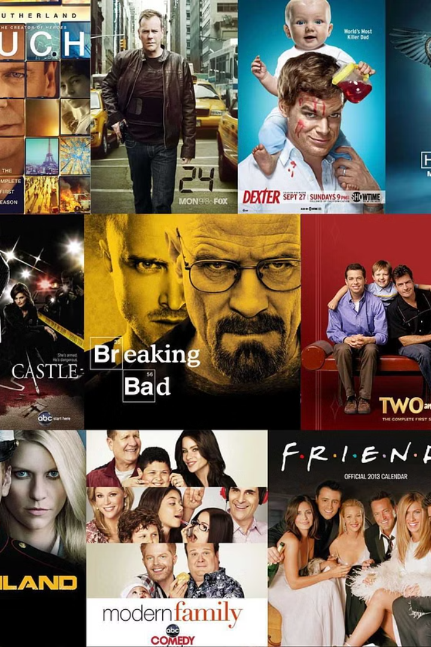
Conclusion
After exploring the world of movies and TV shows on Netflix, it's evident that the platform offers a rich array of entertainment across various genres. The seamless user interface and personalized recommendation algorithms enhance the overall viewing experience, making Netflix a preferred choice for many. As the streaming wars continue, Netflix stands strong as a leader in online streaming, constantly enhancing its content and features to cater to a diverse audience.

